Slide 1
Checking Audiovisual Conformance
@JeromeM78 @dericed @MediaConch
#iasa_web 2017-09-20
Notes:
Dave

Slide 2

MediaArea Team
Project Leaders:
Jérôme Martinez (Digital media analysis specialist)
Dave Rice (Archivist)
Other Members:
Guillaume Roques (Web developer)
Maxime Gervais (Junior developer / automation)
Ashley Blewer (Archivist)
Tessa Fallon (Archivist)

Slide 3
MediaArea contribution to open source
We want to spread open source! → Any platform and distribution kind. We built an automated release system compatible with all tools we worked on.
Tools: MediaInfo, MediaConch, QCTools, BWF MetaEdit, AVI MetaEdit, MOV MetaEdit, DV Analyzer
for: Direct Download for Windows/Mac/Linux, RPM/DEB repository, Mac App Store (Mediainfo/MediaConch/QCTools only, others on the way), directly in Debian/Ubuntu/Fedora repos (MediaInfo/MediaConch only), HomeBrew, LinuxBrew
Interfaces: GUI, WebUI, command line, server mode, library (DLL/SO/DyLib)
Notes:
Jerome

Slide 4
PREFORMA Challenge
Empower memory institutions to gain full control over the technical properties of digital content intended for long-term preservation.
Notes:
Dave
Matroska, FFV1, and FLAC are open file formats. Their specifications are freely available and openly licensed, continued development is open and available to the public, historical context and conversations surrounding the specification are open access, and use of the formats or their specifications is without charge and can be used by any person. They can also be improved upon by any person, contingent only on the standards body to collectively approve of changes.
The benefits of these formats extend beyond their open source status. But to discuss the benefits of these formats, we should first discuss the challenges specific to audiovisual format preservation and issues surrounding the ensured continued transmission of contemporary media artifacts.

Slide 5
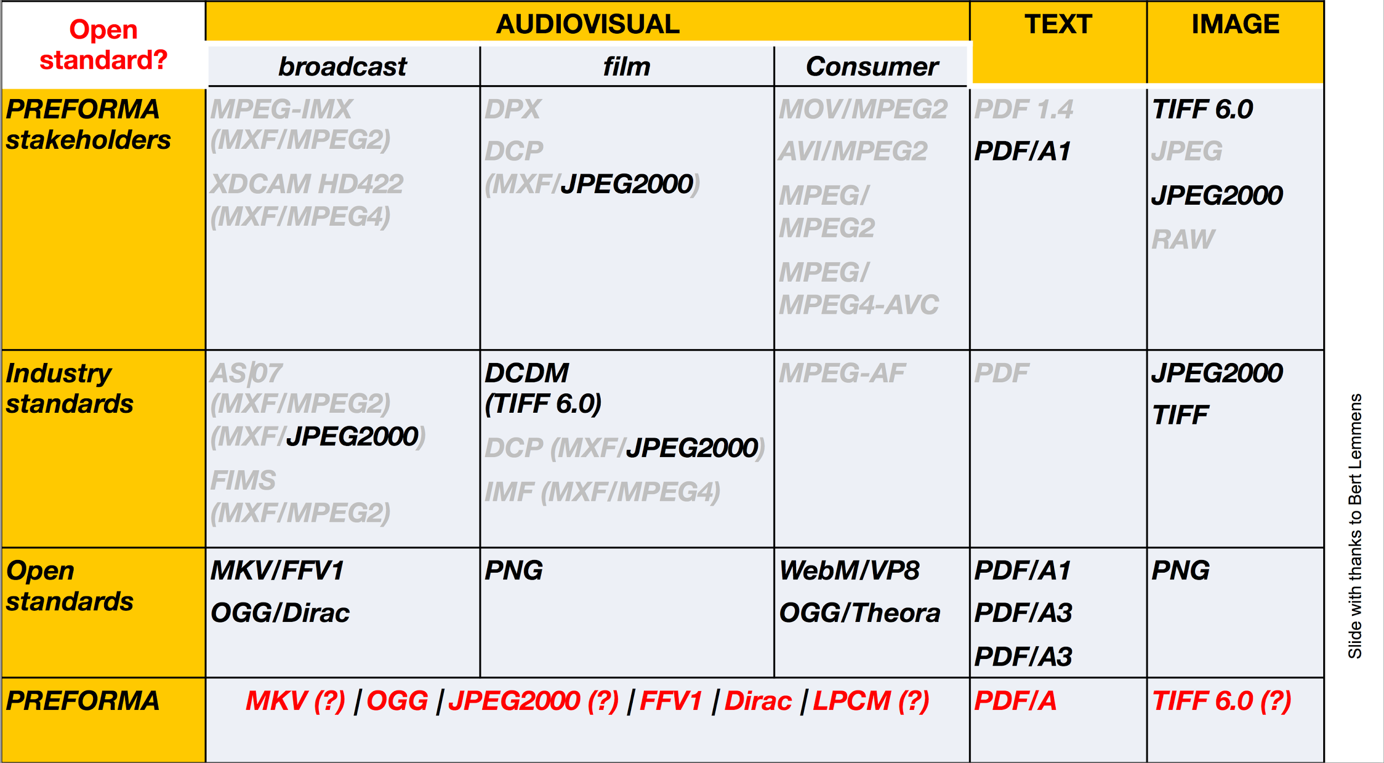

Slide 6
PREFORMA Projects
MediaConch with focus on Matroska, FFV1, PCM
VeraPDF with focus on PDF
DPF Manager with focus on TIFF
Notes:
Jerome else Dave

Slide 7

MediaConch

Slide 8
Conformance Checker:
Implementation Checker
Policy Checker
Reporter
Fixer
Notes:
Dave
Matroska, FFV1, and FLAC are open file formats. Their specifications are freely available and openly licensed, continued development is open and available to the public, historical context and conversations surrounding the specification are open access, and use of the formats or their specifications is without charge and can be used by any person. They can also be improved upon by any person, contingent only on the standards body to collectively approve of changes.
The benefits of these formats extend beyond their open source status. But to discuss the benefits of these formats, we should first discuss the challenges specific to audiovisual format preservation and issues surrounding the ensured continued transmission of contemporary media artifacts.

Slide 9
Tour of MediaInfo and MediaTrace
MediaTrace sample output
<block offset="1920" name="Television information" size="128"> <data offset="1920" name="SMPTE time code">4294967295</data> <data offset="1924" name="SMPTE user bits">4294967295</data> <data offset="1928" name="Interlace" moreinfo="2:1 interlace">255</data> <data offset="1929" name="Field number">255</data> <data offset="1930" name="Video signal standard" moreinfo="Undefined">0</data> <data offset="1931" name="Zero">255</data> <data offset="1932" name="Horizontal sampling rate (Hz)">0.000</data> <data offset="1936" name="Vertical sampling rate (Hz)">0.000</data> <data offset="1940" name="Temporal sampling rate or frame rate (Hz)">0.000</data> <data offset="1944" name="Time offset from sync to first pixel (ms)">0.000</data> <data offset="1948" name="Gamma">0.000</data> <data offset="1952" name="Black level code value">0.000</data> <data offset="1956" name="Black gain">0.000</data> <data offset="1960" name="Breakpoint">0.000</data> <data offset="1964" name="Reference white level code value">0.000</data> <data offset="1968" name="Integration time (s)">0.000</data> <data offset="1972" name="Reserved for future use">(76 bytes)</data> </block>
Notes:
Jerome and Dave
Leave presentation for live demo of MediaInfo and MediaTrace for mkv, mxf, mov, dpx

Slide 10

Notes:
Dave
Matroska as an audiovisual file format has been in use since 2002, with widespread internet usage. Matroska has been adopted as the foundation of Google’s webm format -- a file format optimized specifically for web-streaming. Some of Matroska’s features -- such as subtitle management, chaptering, extensible structured metadata, file attachments, and broad support of audiovisual encodings -- have facilitated its adoption in a number of media communities. Matroska has also been implemented into many home media environments such as Xbox and Playstation and works “out of the box” in the Windows 10 operating system.
The Matroska wrapper is organized into sectional elements [link], and each element may have a dedicated checksum associated with it, which is one of the important reasons why it is deemed such a suitable format for digital preservation. Specific sections of a file can be checked for errors, which means error detection can be more specific to the error’s region (as opposed to having to identify the error within the entire file). For example, a checksum mismatch specific to the descriptive metadata section of the file can be assessed and corrected without having to do quality control and analysis on the file’s content streams. The Matroska format features embeddable technical and descriptive metadata so that contextual information about the file can be embedded within the file itself, not just provided alongside in a different type of document.

Slide 11
EBML & Matroska
Extensible Binary Meta Language (EBML is a Binary XML format)
An EBML Schema defines an EBML Document like an XML Schema defines an XML Document
Matroska and webm are EBML Document Type
Storage is based on a structure of Element ID, Element Data Size, and Element Data
Unlike XML, an EBML Document requires an EBML Schema to be interpreted semantically
Notes:
Dave

Slide 12
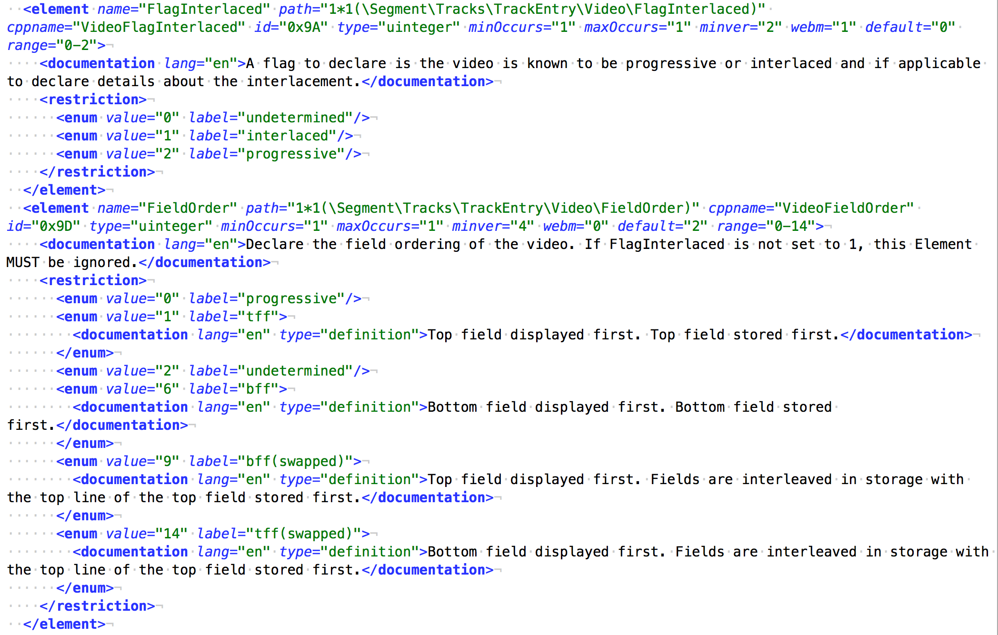
Notes:
Dave: EBML Schema for interlacement values

Slide 13
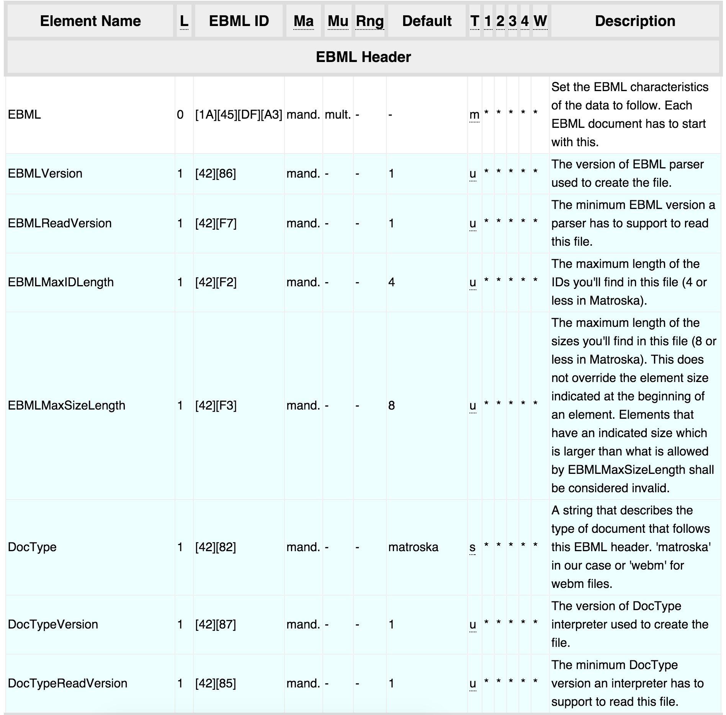

Slide 14
EBML & Matroska
<EBML>
<EBMLVersion>1</EBMLVersion>
<EBMLReadVersion>1</EBMLReadVersion>
<EBMLMaxIDLength>4</EBMLMaxIDLength>
<EBMLMaxSizeLength>8</EBMLMaxSizeLength>
<DocType>matroska</DocType>
<DocTypeVersion>4</DocTypeVersion>
<DocTypeReadVersion>2</DocTypeReadVersion>
</EBML>
<Segment>
<Info>
<CRC-32>54272a11</CRC-32>
<TimecodeScale>1000000</TimecodeScale>
<MuxingApp>Lavf57.50.100</MuxingApp>
<WritingApp>Lavf57.50.100</WritingApp>
<SegmentUID>efd46d3ed630381ef9021d1d4ed5a81a</SegmentUID>
<Duration>40.0</Duration>
</Info>
<Tracks>
<TrackEntry>
<TrackNumber>1</TrackNumber>
<TrackUID>1</TrackUID>
<FlagLacing>0</FlagLacing>
<Language>und</Language>
<CodecID>V_MPEG4/ISO/AVC</CodecID>
<TrackType>1</TrackType>
<DefaultDuration>40000000</DefaultDuration>
<Video>
<PixelWidth>320</PixelWidth>
<PixelHeight>240</PixelHeight>
<FlagInterlaced>2</FlagInterlaced>
<DisplayWidth>320</DisplayWidth>
<DisplayHeight>240</DisplayHeight>
<unknown_55b0>55bb8101</unknown_55b0>
</Video>

Slide 15
FFV1 perks
Losslessness
Fixity
Self-description
Size
Notes:
Checksum information can be automatically gathered upon file creation for each individual frame within the video stream. FFV1 version 3 stores CRCs (cyclic redundancy check) in frame headers to allow verification of the encoded data and ability to store error status messages. With frame CRCs, a preservationist is able to determine exactly which frame is affected by any error of digital storage. With this level of specificity, the exact error and severity of damage is easily able to be identified.

Slide 16
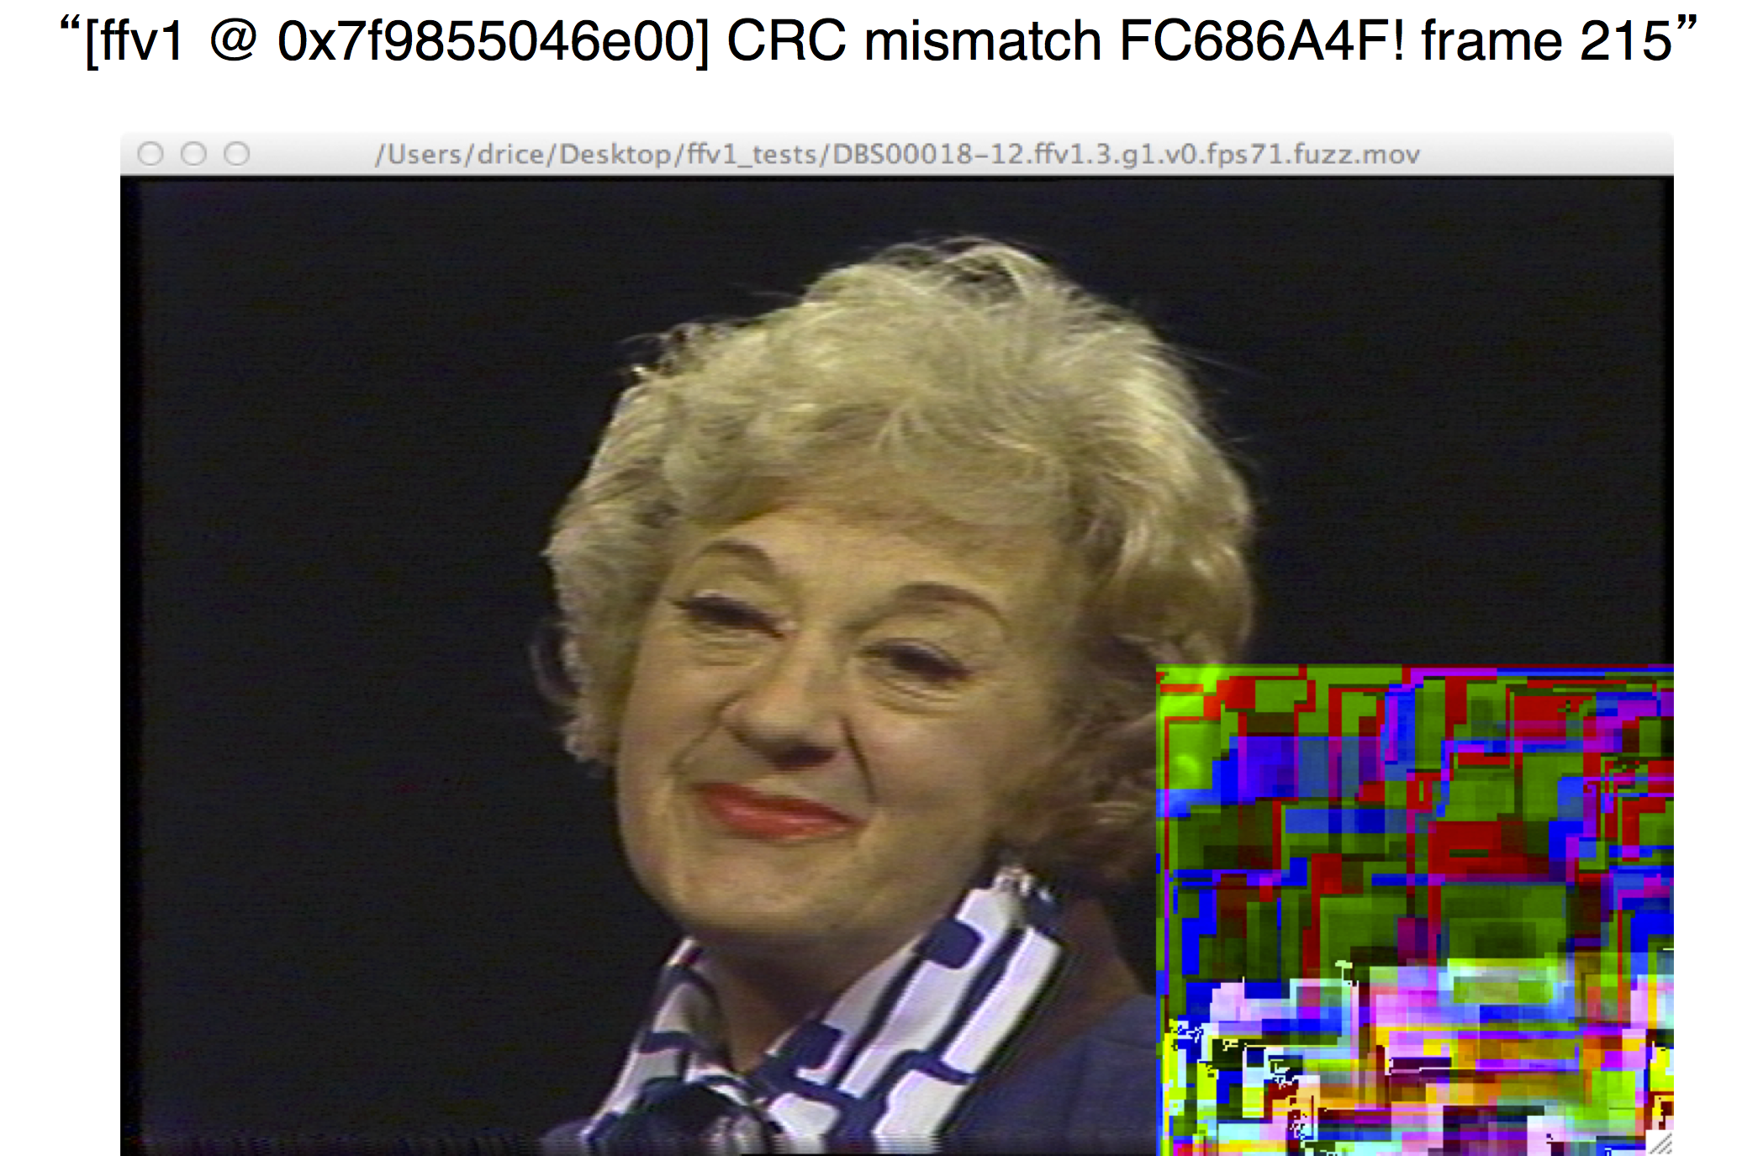
Notes:
Another benefit of FFV1 is that it is a multithreaded codec. FFV1 frames may be sliced into components to be encoded or decoded on multiple cores of processors. This multithreading support allows FFV1 to achieve speeds far greater than other lossless video codecs.
Additionally FFV1 allows CRC at the slice level. This feature enables an FFV1 decoder to conceal the specific damaged slice of a frame by substituting the corresponding slice of the previous frame.

Slide 17
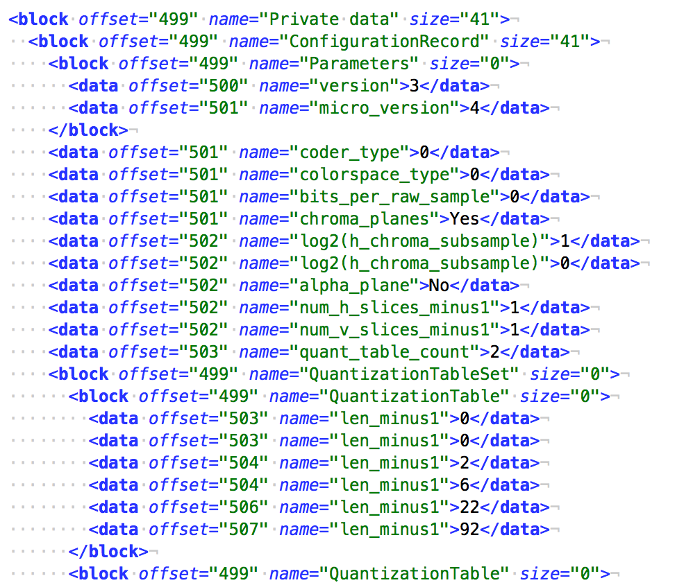

Slide 18
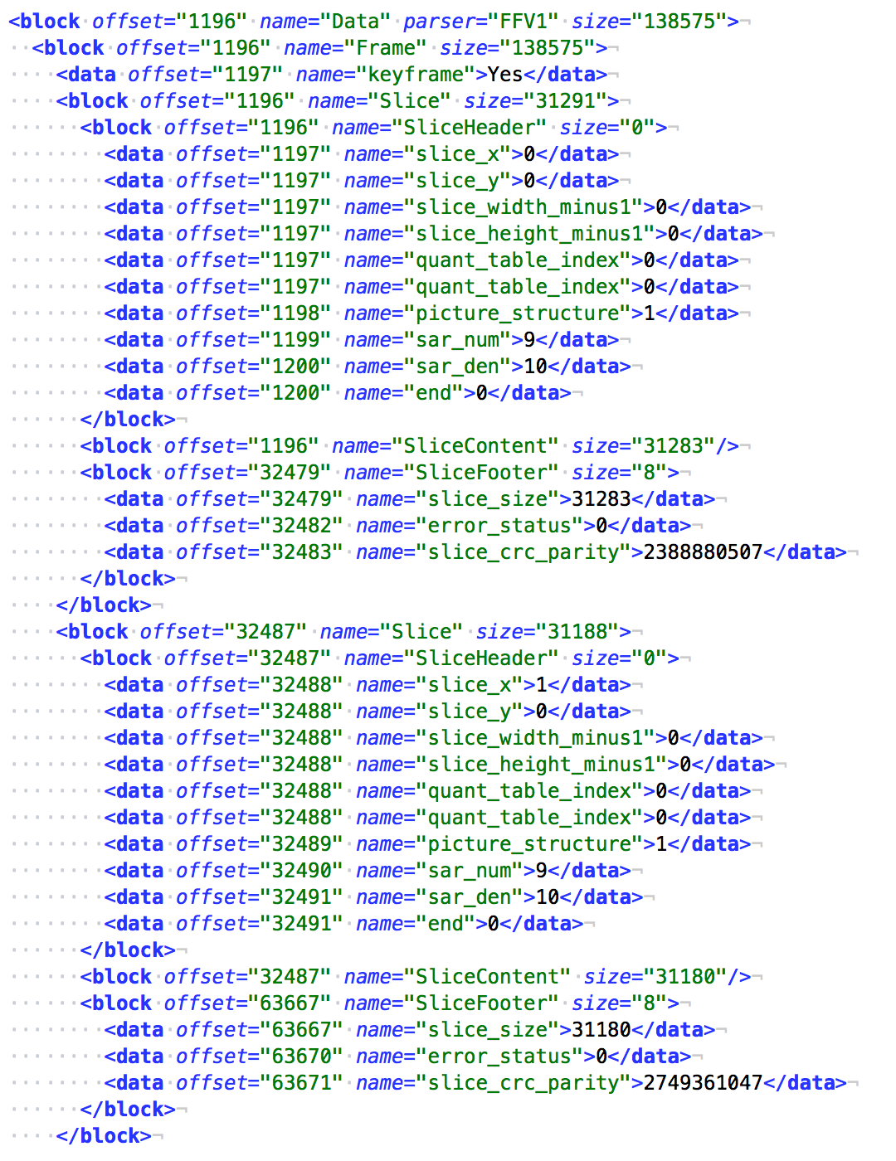

Slide 19
Tour of MediaConch
Implementation
Notes:
Jerome and Dave
Leave presentation for live demo of MediaConch for MI/MT integration, checking, policies, public policies, CLI

Slide 20
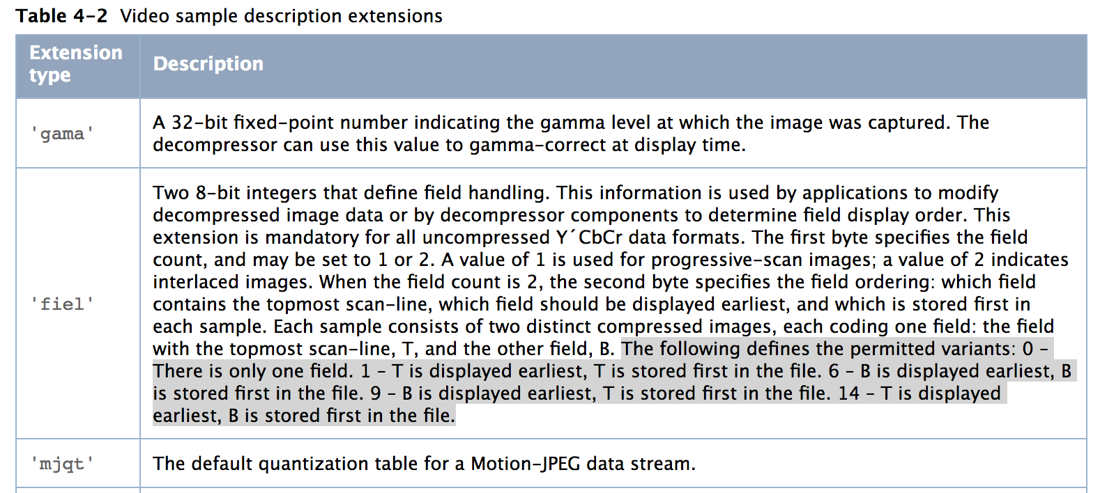

Slide 21
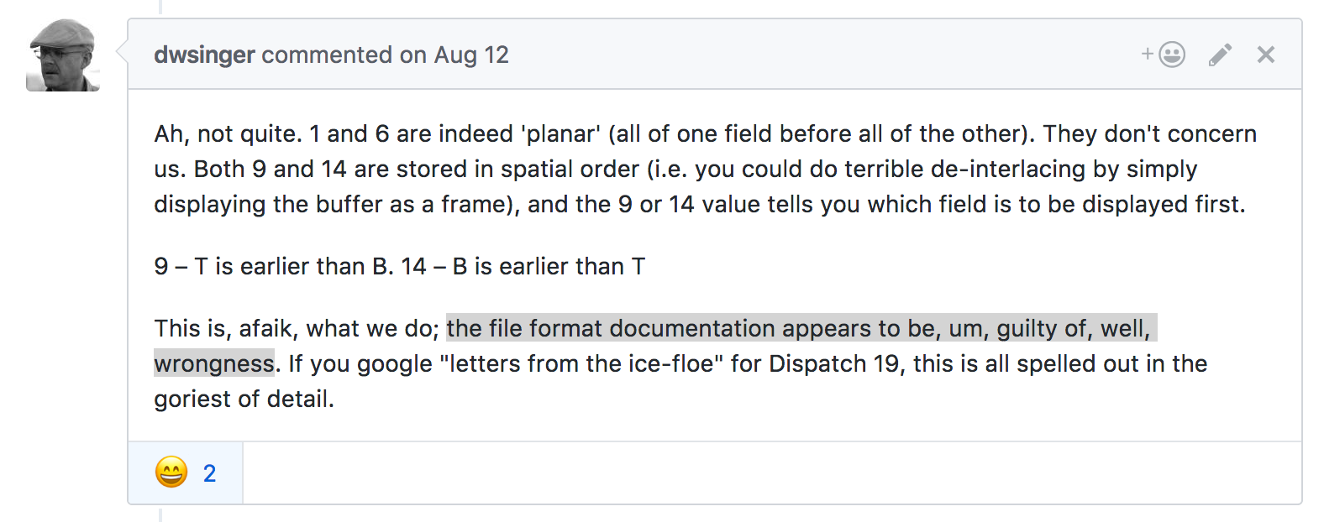

Slide 22
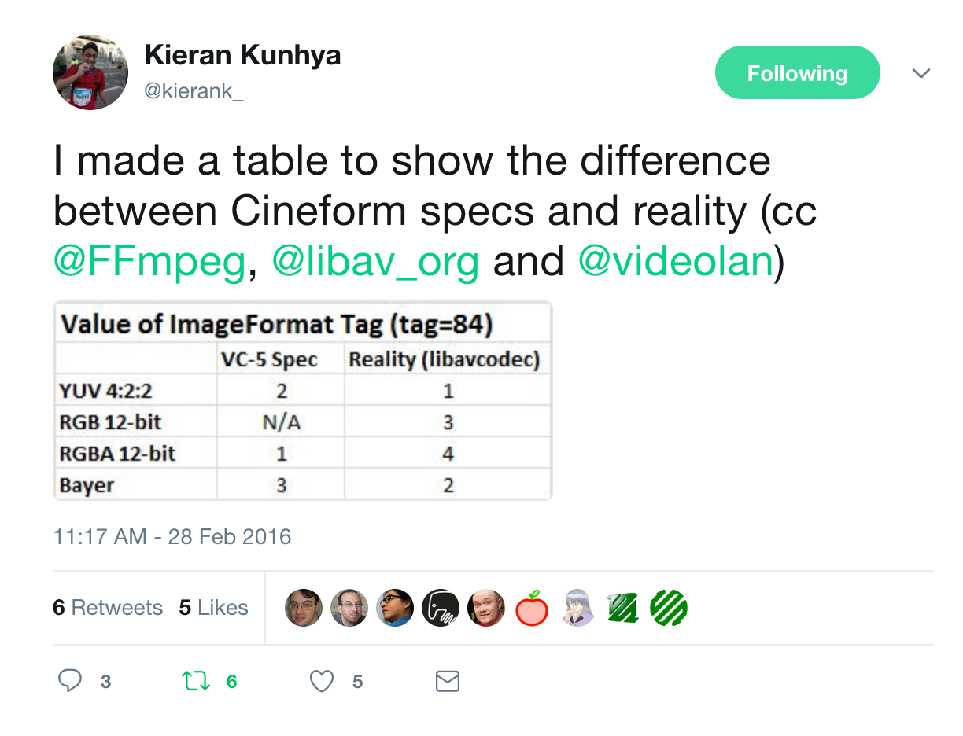

Slide 23
Policy Example: Apple’s TN2162 (Uncompressed MOV)
Using these labels, application and device developers can finally relieve end users of the following nagging usability problems:
"I captured this file on a Mac but it looks dark on a PC."
"I rendered to this file in app A; it plays ok in MoviePlayer but looks like snow in app B."
"I captured this data and the colors look wrong on my computer screen."
"I captured this data but the fields are swapped when I play it back. My application has 6 different field-related controls and I've tried all 64 combinations but none of them work."
"I captured and played this data OK, but whenever I try to render or do effects using this data, there are stuttery forward-backward motion problems."
"I captured this data and it looks squished or stretched horizontally."
"Circles I lay down in my application don't look circular on the video monitor."
"I am compositing similar video footage which I had captured with two different devices, and the video data is shifted horizontally. No setting of captured image size seems to help."

Slide 24
Tour of MediaConch
Policy
Notes:
Jerome and Dave
Leave presentation for live demo of MediaConch for MI/MT integration, checking, policies, public policies, CLI

Slide 25

Notes:
Tessa. The notes below are from the iPres paper, feel welcome to deviate.
The Internet Engineering Task Force is an open and independent international standards organization, known for the development of standards for the Internet protocol suite (TCP/IP), file transfer protocol (FTP), and protocols that compose the Simple Mail Transfer Protocol (SMTP). IETF’s parent organization is the Internet Society (ISOC), an international, non-profit organization that has set out to “make the world a better place” by “connecting the world, working with others, and advocating for equal access to the Internet.” [link] Much of the standardization work shepherded by IETF focuses on the development of standards of and is related to the transmission of information between systems in an efficient manner without error or data loss. The working methods of IETF promote and ensure a high degree of transparency so that anyone is able to look upon processes underway and to participate within them. Communication is well-organized into a system of publicly accessible mailing lists, document trackers, and chatrooms. The IETF’s conferences (held three times per year) include audiovisual streams, IRC streams, and an in-room facilitator for remote participants to efficiently invite and enable participants in the process.

Slide 26
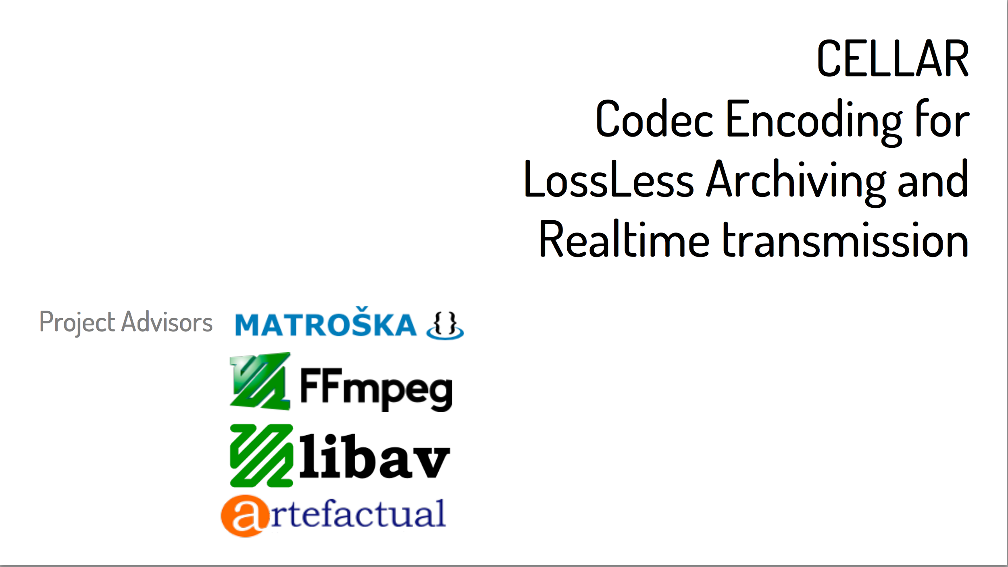

Slide 27
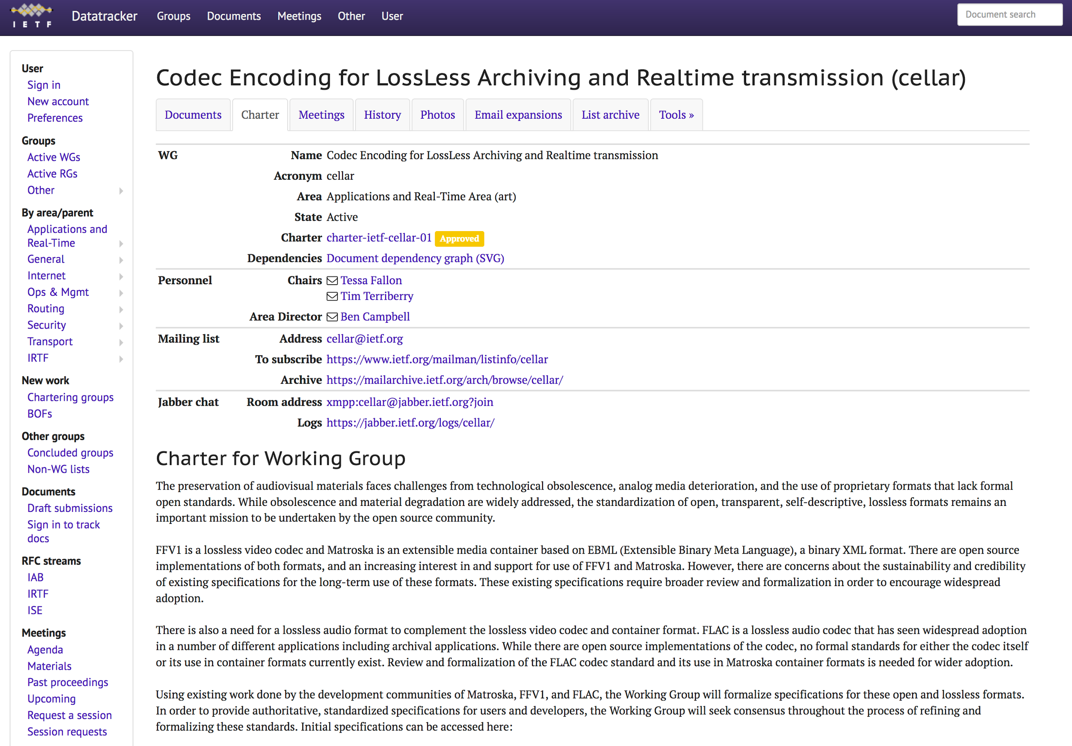
Notes:
Tessa Fallon: EXPLAIN THE NAME; looking for reviewers, editors, contributors, task masters; anyone involved in ffmpeg, flacdev, or matroska should be on and participating in CELLAR list; updating our milestones, assigning document shepherds
CELLAR is a title of an IETF working group, an acronym for Codec Encoding for LossLess Archiving and Realtime transmission. The working group is chartered to develop specifications for three audiovisual formats: FFV1, Matroska, and FLAC. I’ll provide an overview of these formats shortly.
Tessa Fallon presented a proposal for the working group at the 2015 IETF conference in Prague within a complex and trial-by-fire process. After presentations, charter drafts, collaboration with the originating communities of the formats, and votes within the IETF, the working group’s charter was approved by the IETF on November 20, 2015.

Slide 28
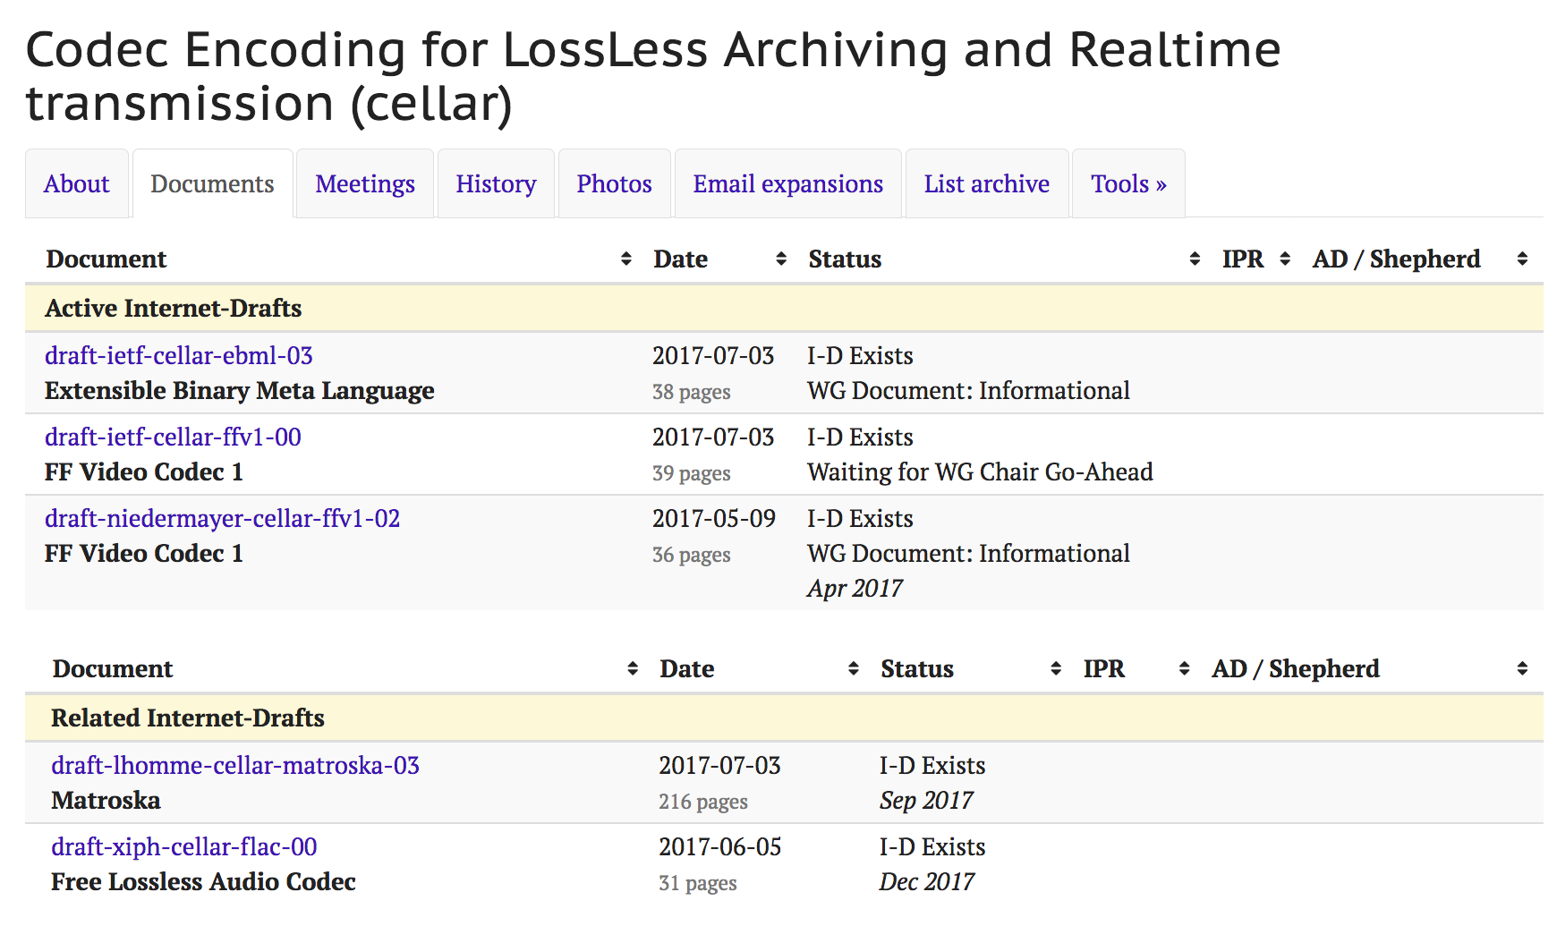

Slide 29


What is Archivematica?
An open-source platform for digital preservation which packages digital objects for long-term storage. Archivematica makes AIPs (Archival Information Packages).
What is MediaConch?
An open-source implementation and policy checker for Matroska* and FFV1** files. Developed by MediaArea (see: MediaInfo) and funded by PREFORMA.
Achieves two things: 1., are my files valid according to the specification? And 2., do they conform to our local policies?
*A container format for video, audio, related streams **A lossless video encoding

Slide 30

Workflow
Archivematica processes the video files, and draws upon its rules stored in the Format Policy Registry (FPR)
FPR
MediaConch writes output for the validation/policy checks to a METS file which Archivematica stores with the digital objects in an Archival Information Package (AIP).
The FPR contains commands to
run MediaConch for validation of
file formats, and checking of local policies

Slide 31
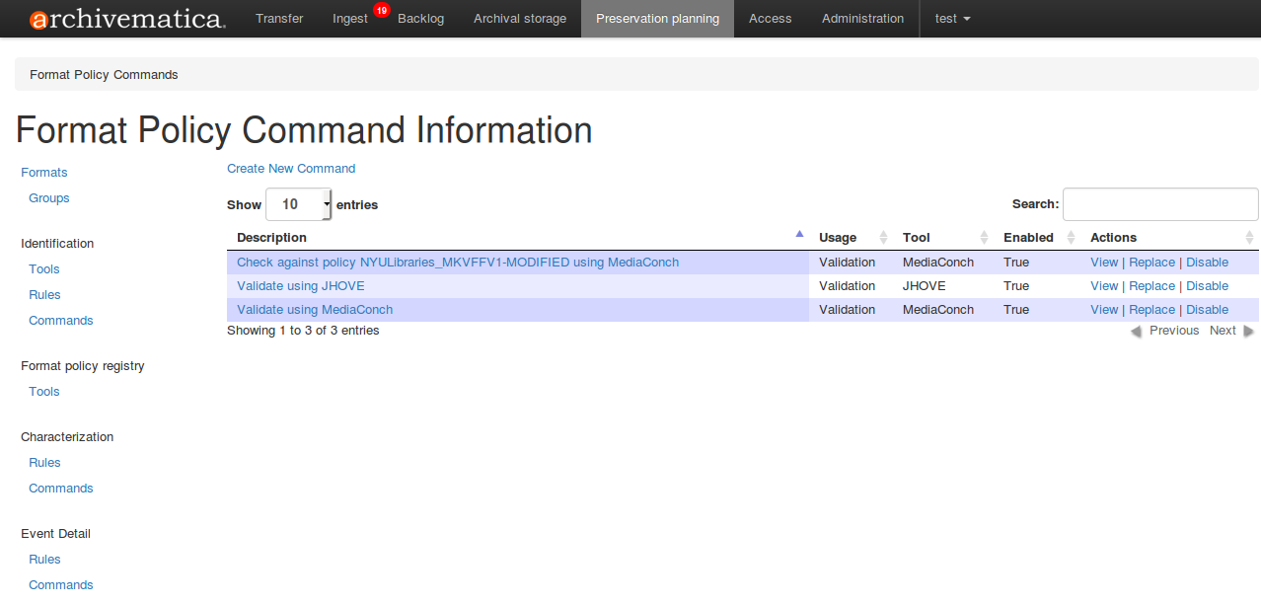
Update one: made new commands
New!

Slide 32
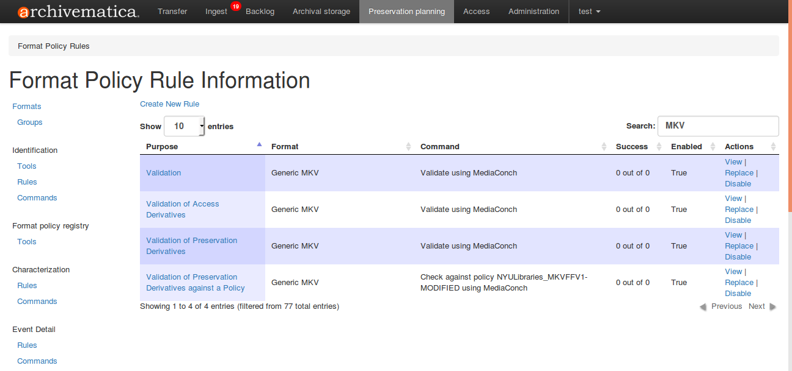
Update two: made new rules
All new!

Slide 33
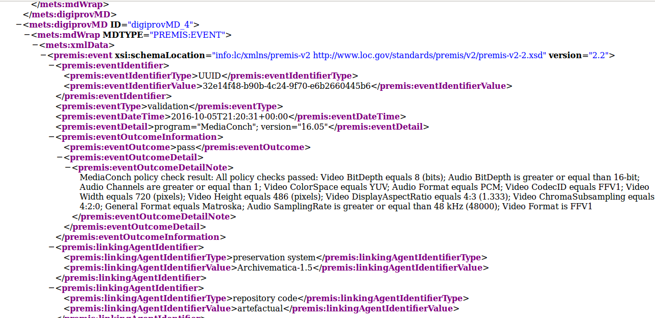
Update six: METS-all-the-things

Slide 34
FFV1 in VIAA
Test on real files Speed tests (FFmpeg FFV1 decoding faster than FFmpeg JP2k decoding) Automation of transcoding from MXF/JP2k/PCM to MKV/FFV1/FLAC + derivate files, then conformance checking and test of framehash of MKV/FFV1/FLAC files. Compression ratio tests
Report: https://viaa.be/files/attachments/.669/VIAA_Preservation_Reformatting.pdf

Slide 35
MediaInfo
“MIXML”: working on a true XML output, less tied to text output EBUCore 1.8, including Sony Acquisition Metadata full parsing EBUCore 1.8 JSON output HDR Metadata (preferred_transfer_characteristics, MaxCLL, MaxFALL, MasteringDisplay_ColorPrimaries, MasteringDisplay_Luminance) Example of 608/708 extraction and decoding from MXF/ANC/CDP

Slide 36
BWF MetaEdit
Supports embedding, validating, and exporting of metadata in Broadcast WAVE Format (BWF) files. It supports the FADGI (Federal Agencies Digitization Guidelines Initiative) for embedded metadata in the bext and INFO chunks.
Initially funded by the Library of Congress and FADGI designed and led by AVPreserve developed by MediaArea.

Slide 37
BWF MetaEdit update by MediaArea (soon!)
General maintenance: Update of third party libs (Qt) Drag and drop was not working on newest versions of macOS Support of latest versions of Debian, Ubuntu, Fedora, RHEL/CentOS...
Bug fixes: Fix sync issues between samples count and translated timestamp Unknown loudness was stored as 0x0000 but specs says it must be 0x7FFF CodingHistory edition was not working well on macOS CodingHistory was not correctly reading history with carriage returns Fix crash with some files
Improvements: Commmand line option for outputing XML report to a specific file

Slide 38
MOV MetaEdit
New project Code on GitHub, snapshots available Release in October 2017
Currently focused on 2 items: - add/edition of the “pasp” atom (anonymously sponsored, CLI only) - add/edition/delete of “Universal Ad ID” metadata (sponsored by Ad-ID)
Core of the program built for extensibility, can be extended depending of sponsor

Slide 39
Specification Development via GitHub
https://github.com/Matroska-Org/ebml-specification
https://github.com/Matroska-Org/matroska-specification
https://github.com/FFmpeg/FFV1/
https://github.com/xiph/flac
https://www.ietf.org/mailman/listinfo/cellar
Notes:
Next meeting: spring 2017 Chicago, July 2017 prague

Slide 40
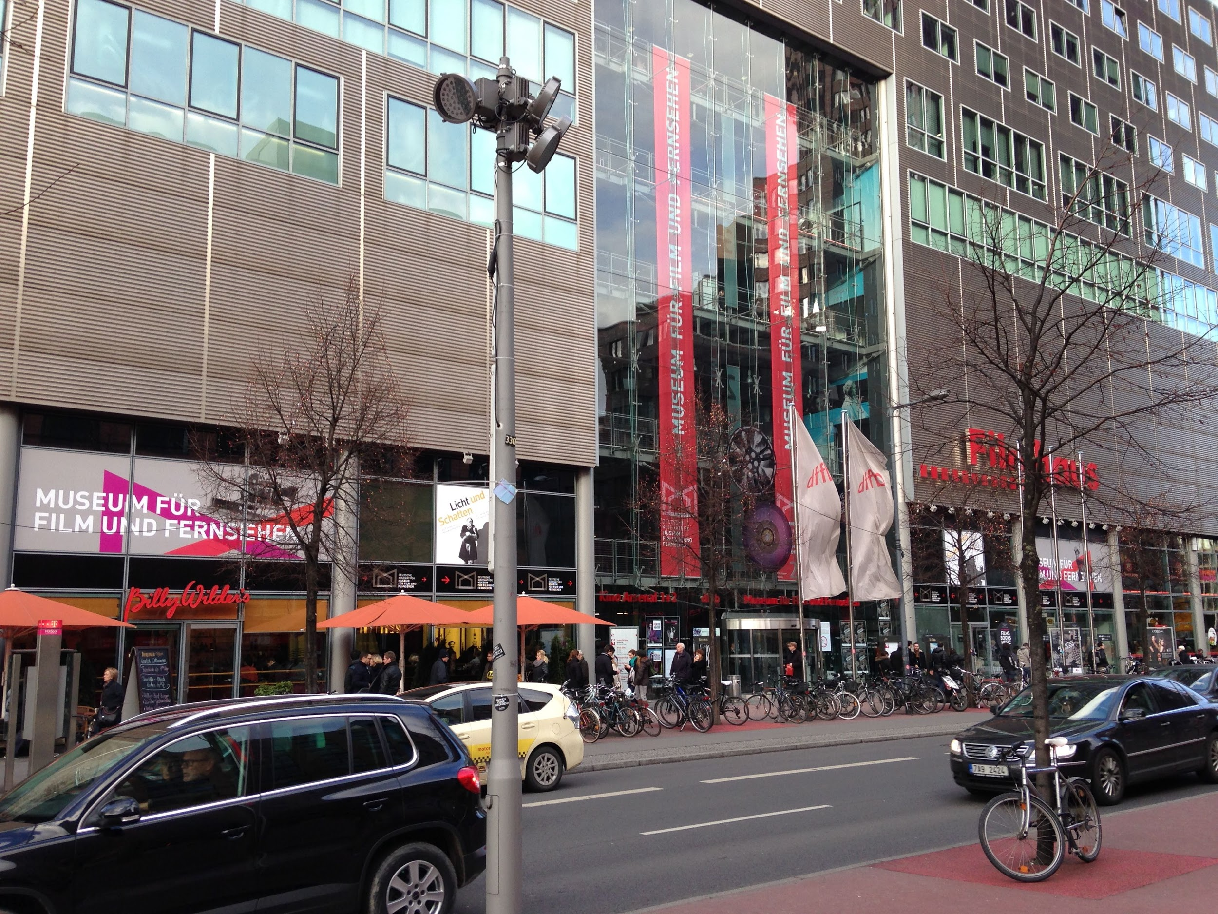
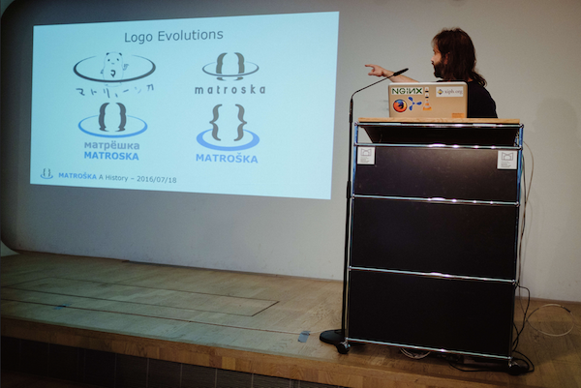
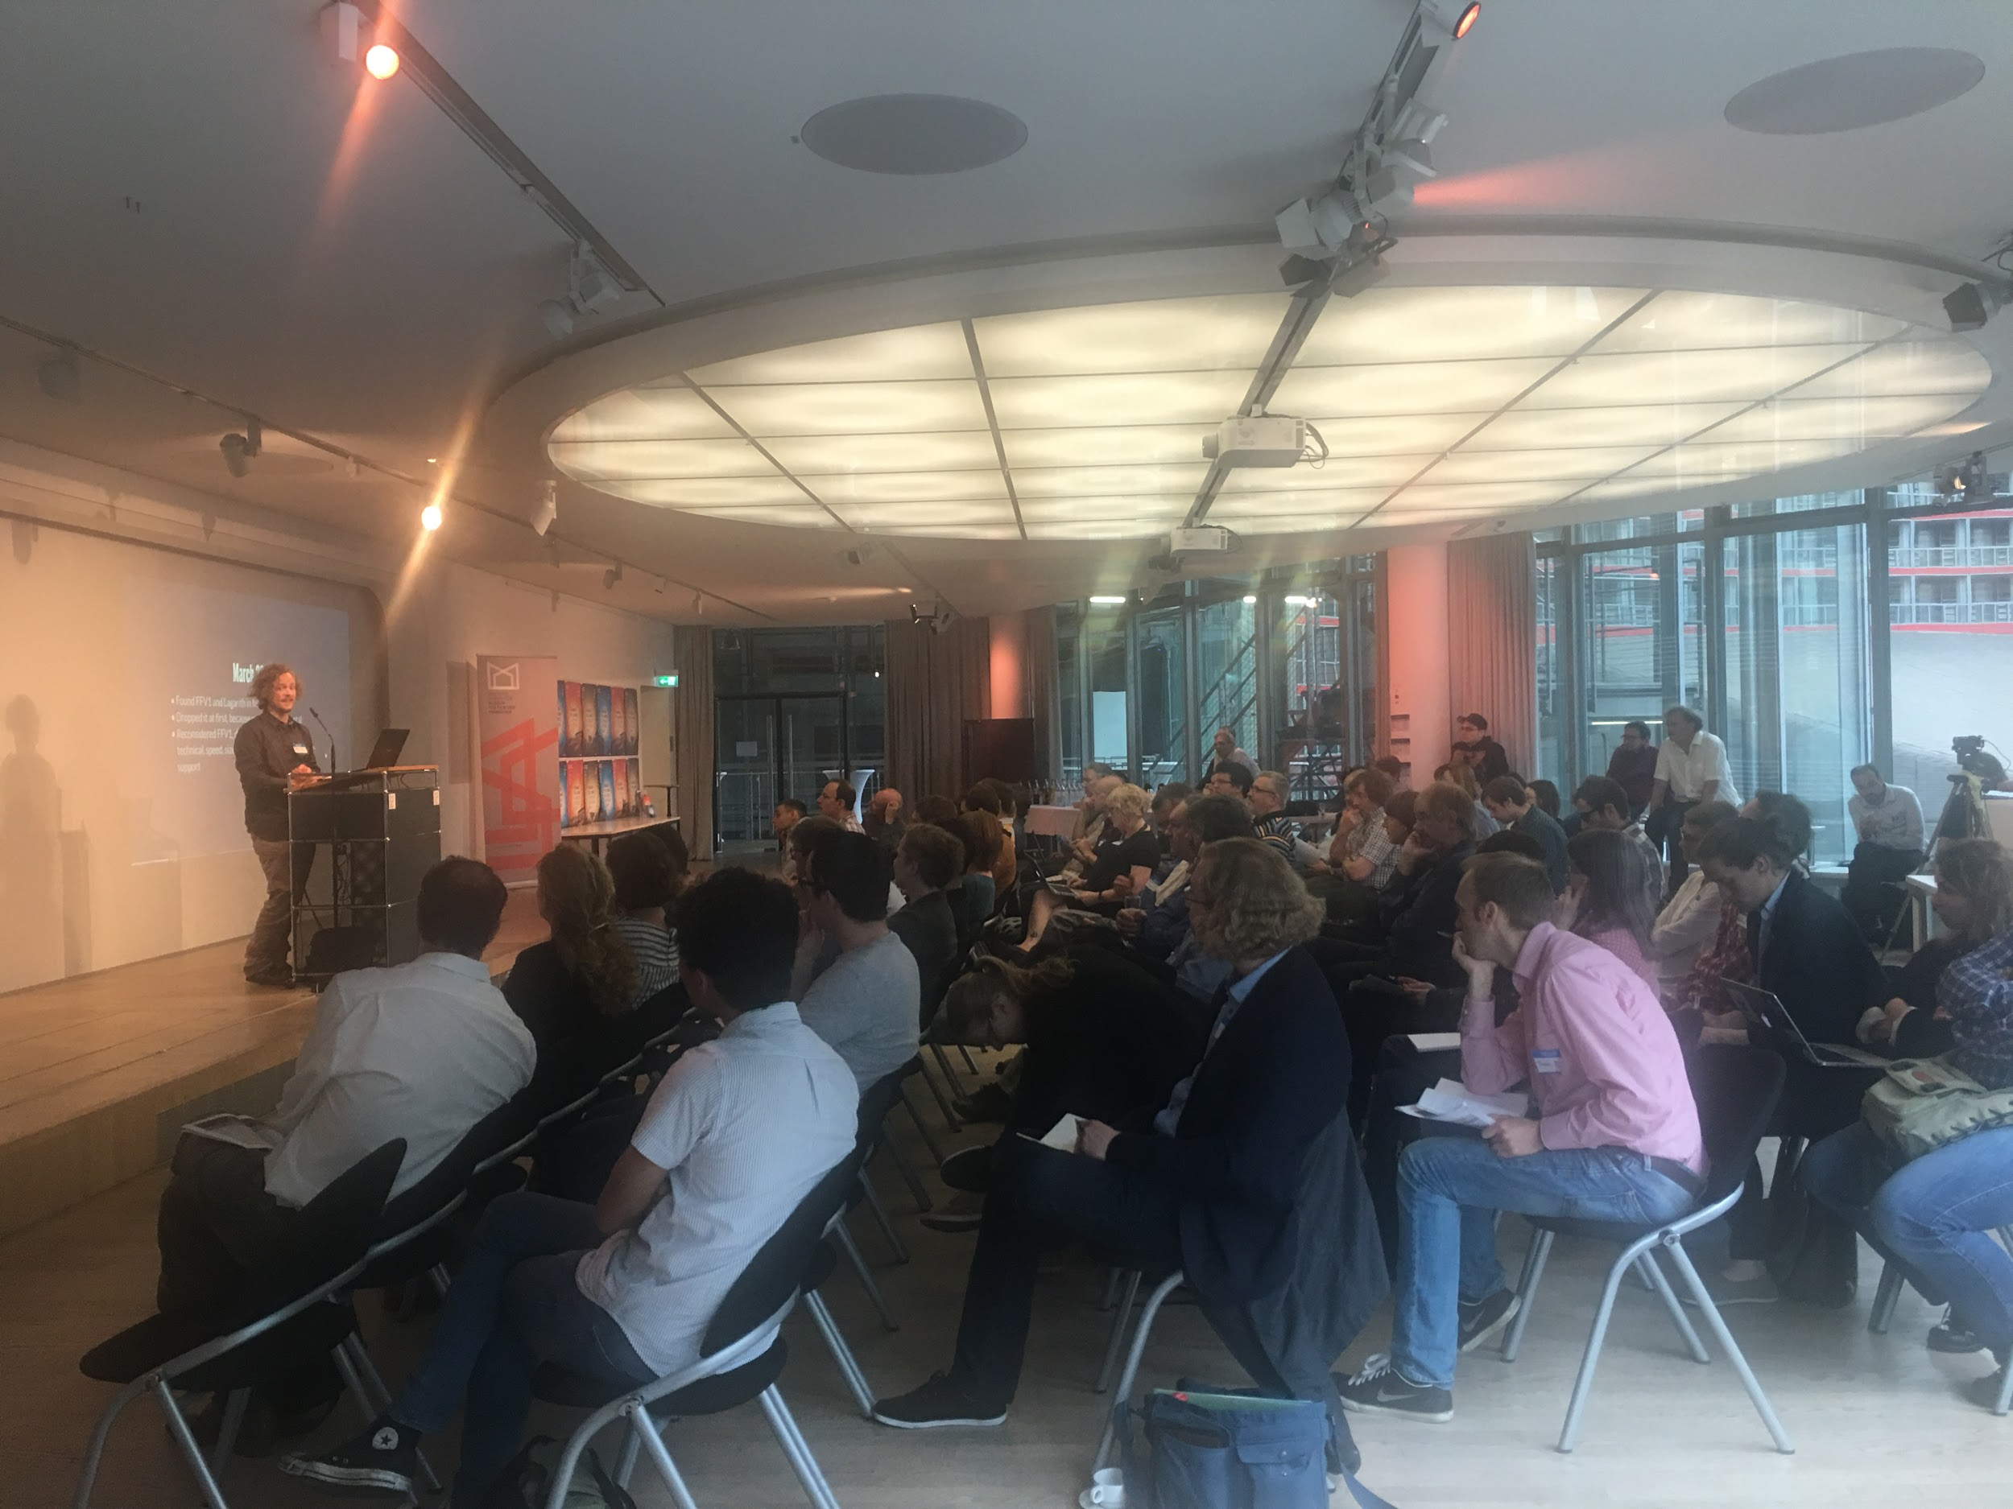
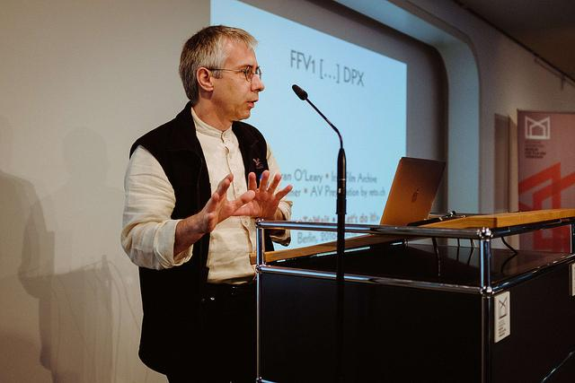
No Time To Wait 2016 - An Matroska & FFV1 Symposium
Notes:
A significant boost to our work was the No Time to Wait symposium held in July of this year, funded by the PREFORMA through the MediaConch project and hosted by the Deutsche Kinemathek and the Zuse Institute of Berlin. This 3 day symposium was designed as an event for archivists and developers to work collaboratively on Matroska and FFV1 concurrently to the working group meeting of the IETF, also held in Berlin at that time.

Slide 41
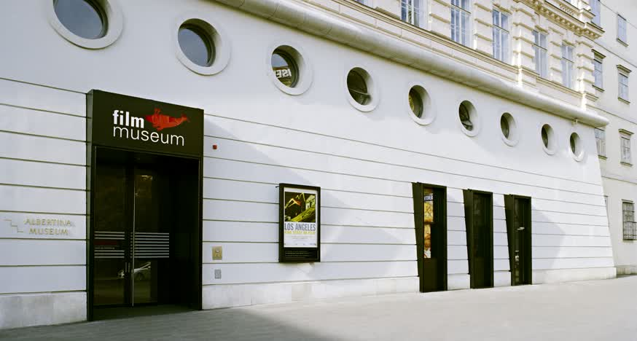
No Time To Wait 2017 - November 9/10 Vienna
“open media, standardization, and audiovisual preservation”
https://mediaarea.net/MediaConch/notimetowait2.html
Notes:
A significant boost to our work was the No Time to Wait symposium held in July of this year, funded by the PREFORMA through the MediaConch project and hosted by the Deutsche Kinemathek and the Zuse Institute of Berlin. This 3 day symposium was designed as an event for archivists and developers to work collaboratively on Matroska and FFV1 concurrently to the working group meeting of the IETF, also held in Berlin at that time.

Slide 42
Stay in touch
MediaArea: https://mediaarea.net, @MediaArea_net MediaConch: https://mediaarea.net/MediaConch, @MediaConch
Jérôme Martinez: jerome@mediaarea.net Dave Rice: https://twitter.com/dericed
Slides: https://mediaarea.net/Events
Archivematica related slides from Artefactual
License: CC BY

